Slide 1
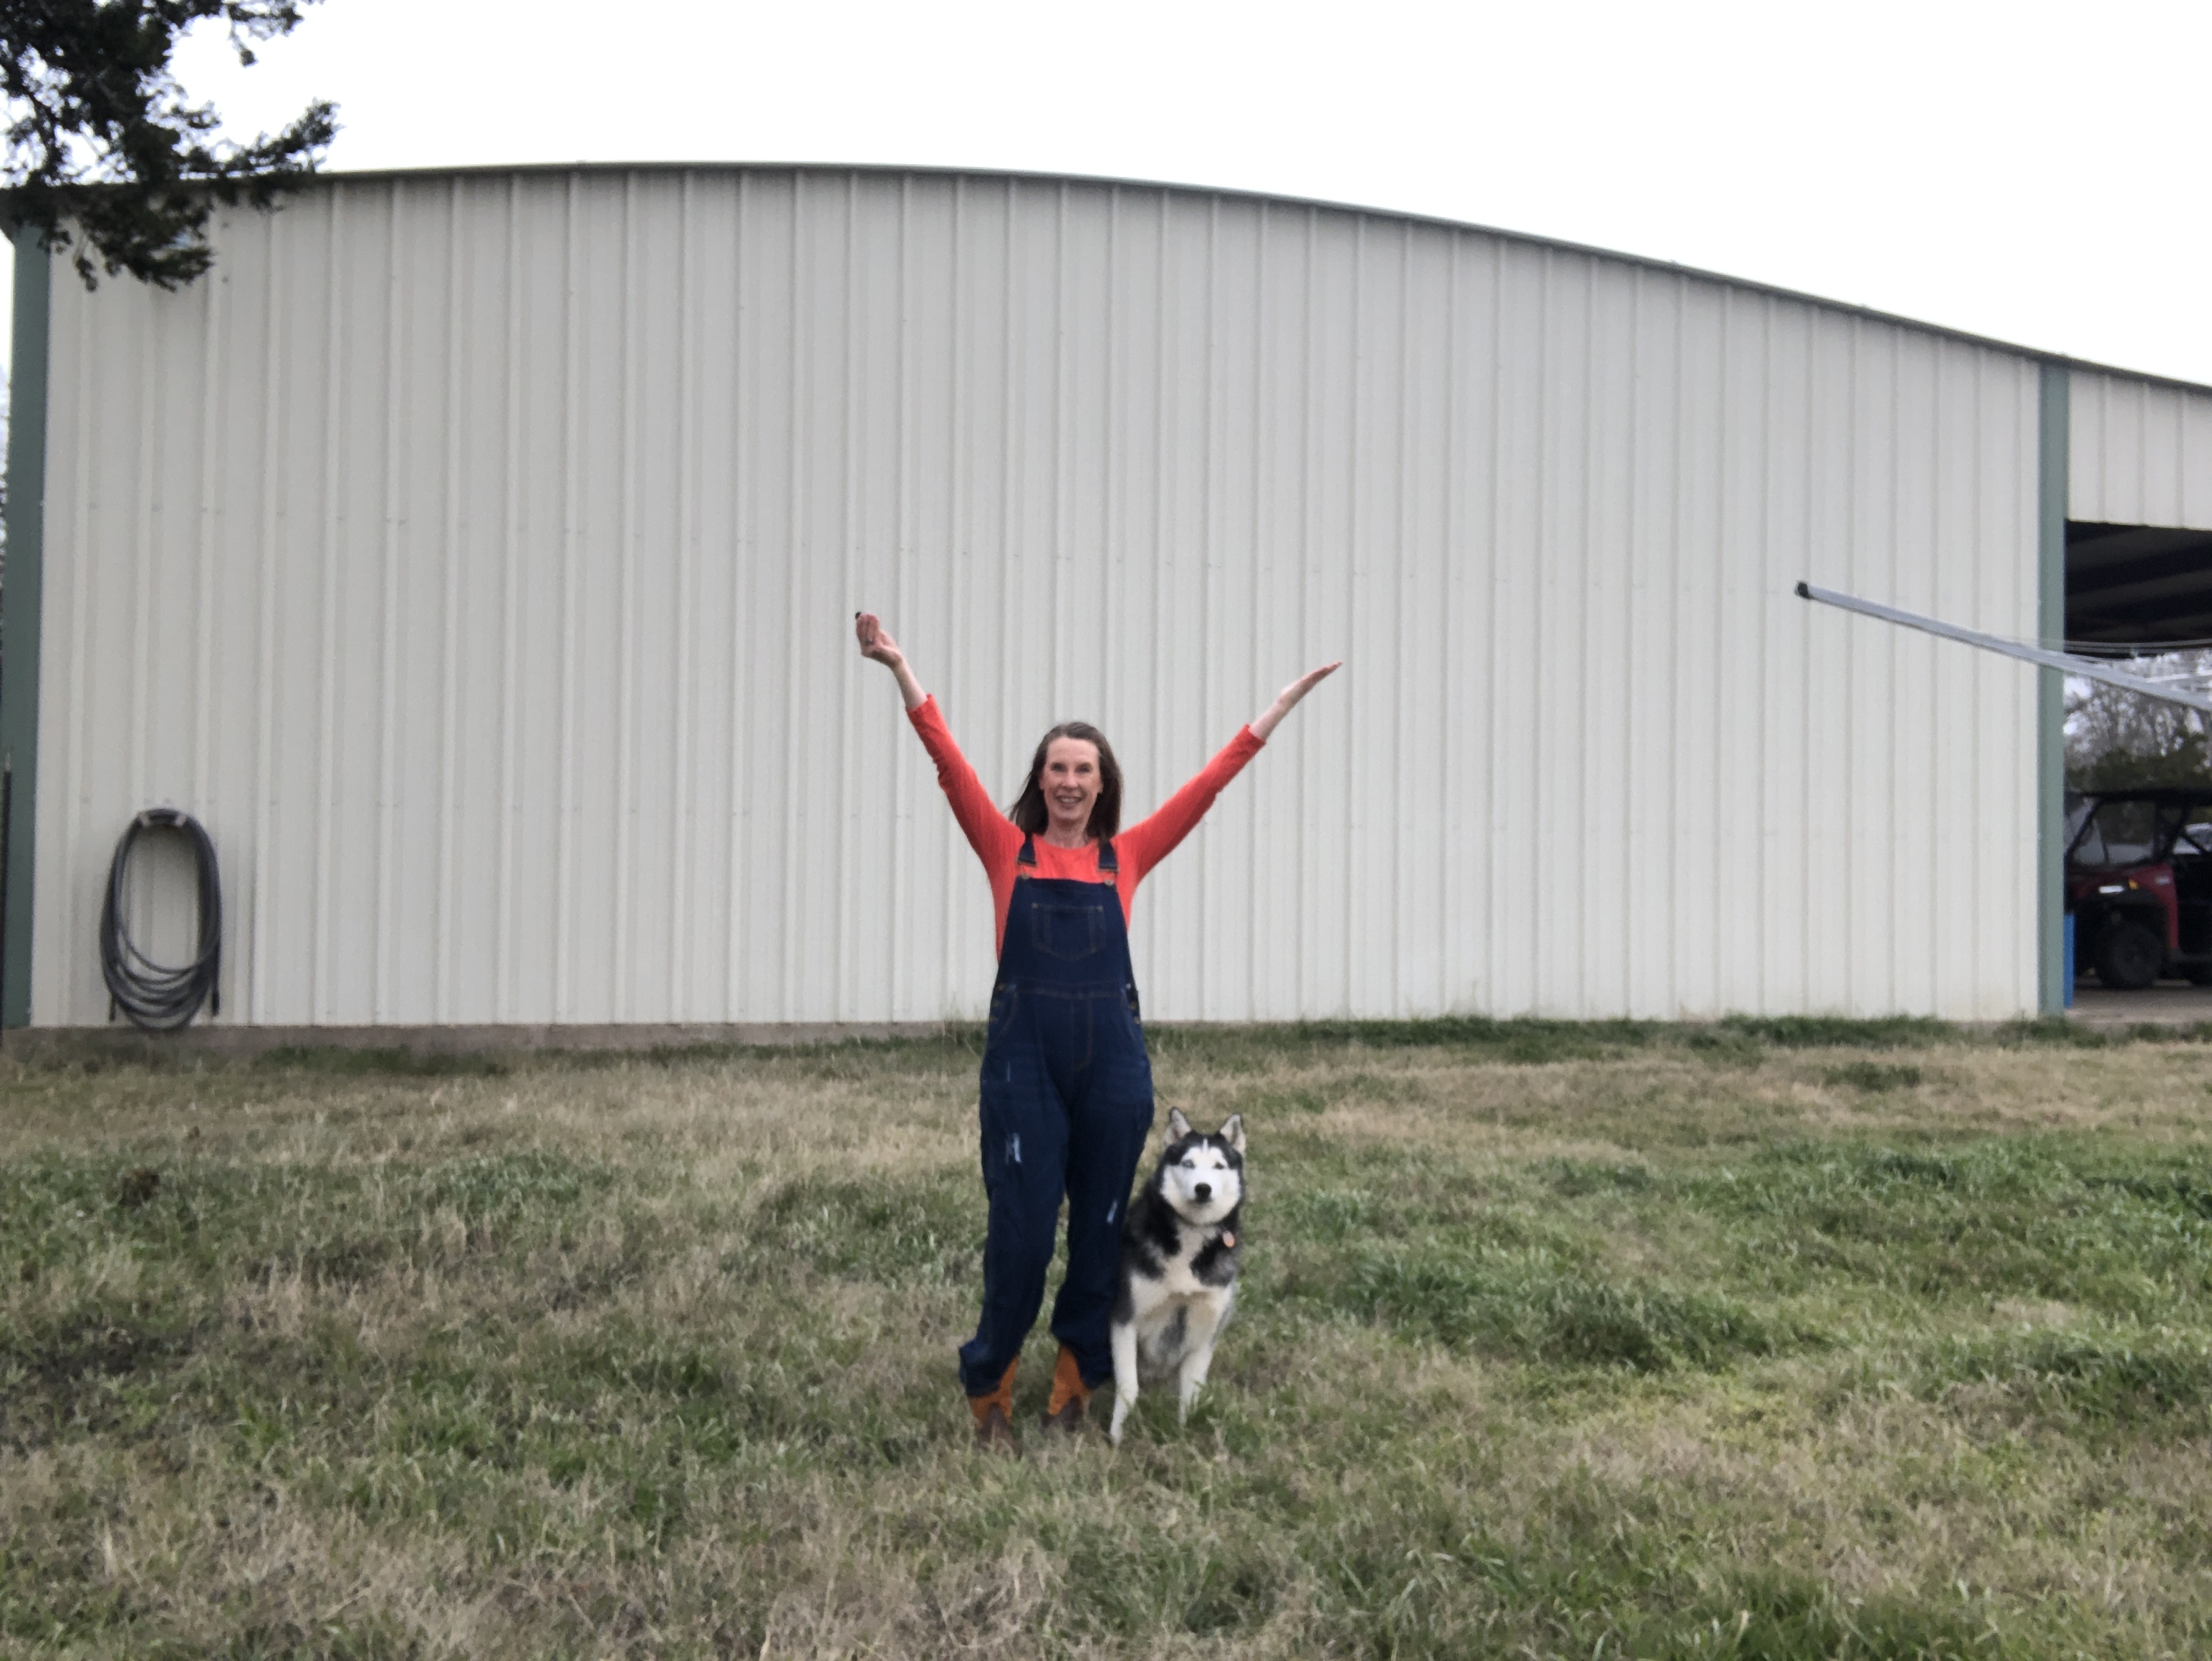
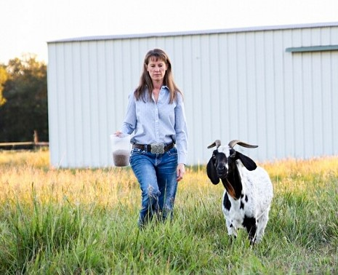
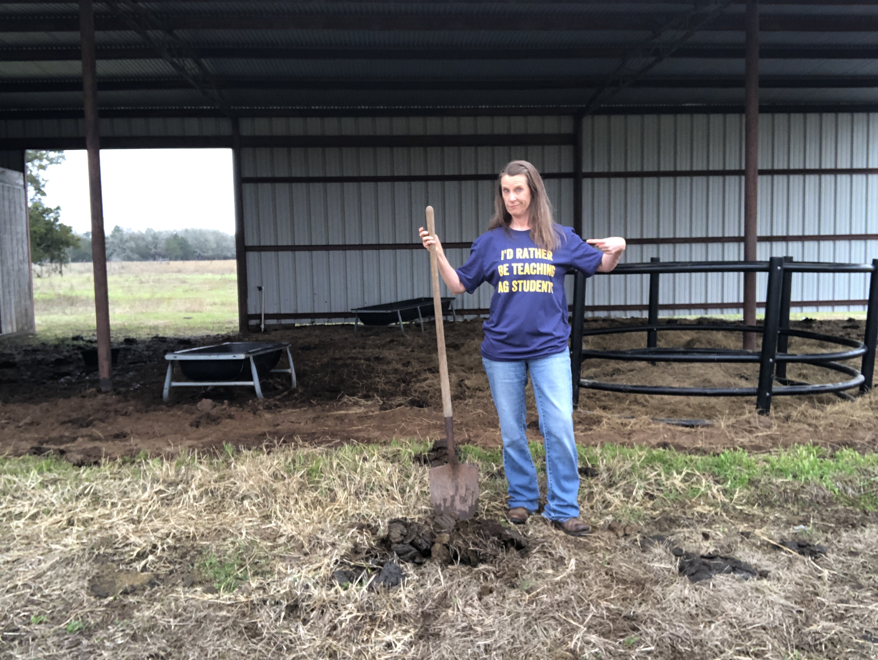
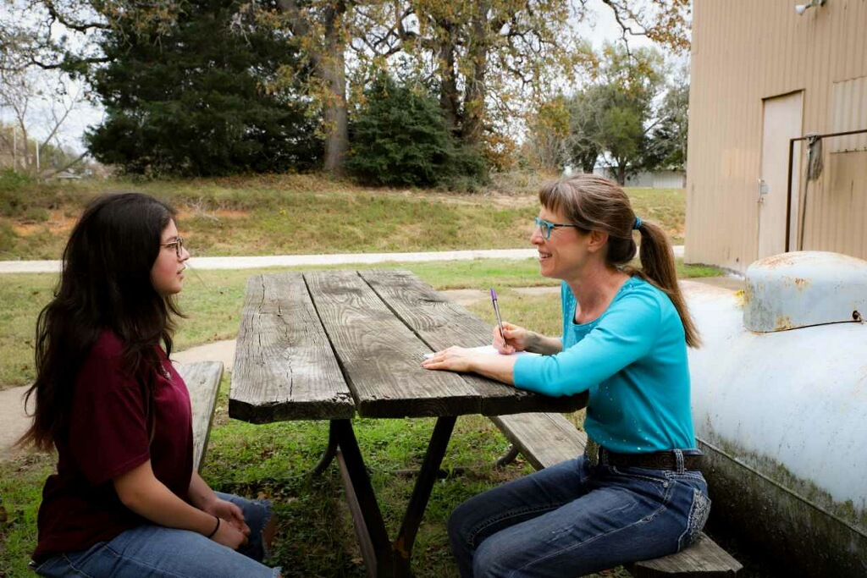
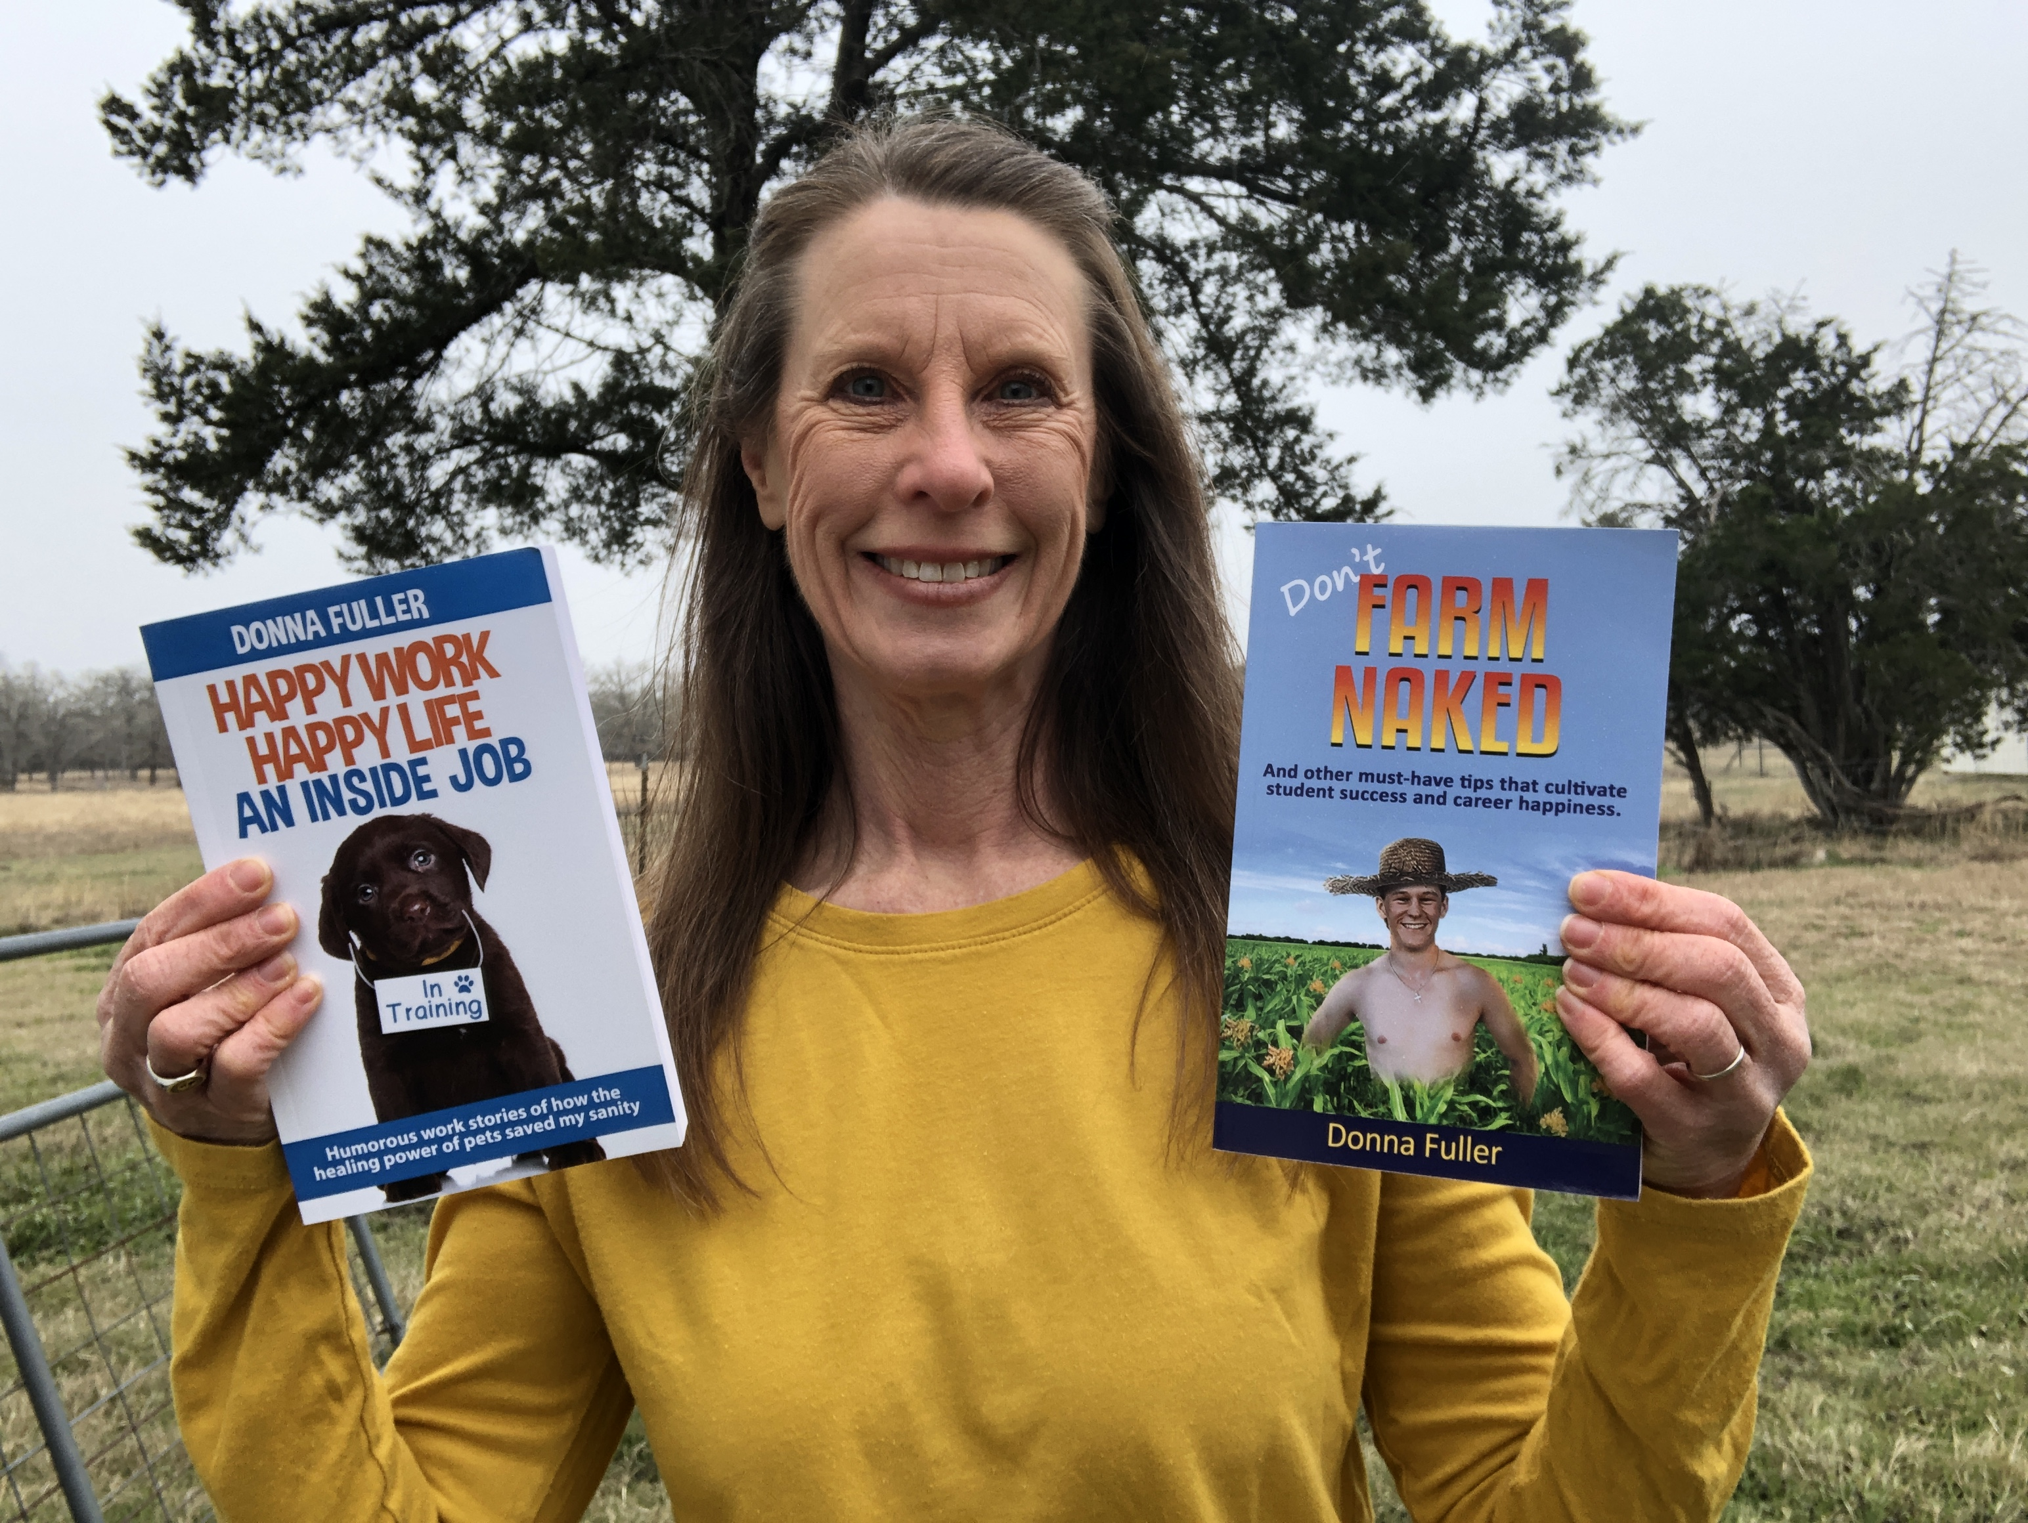

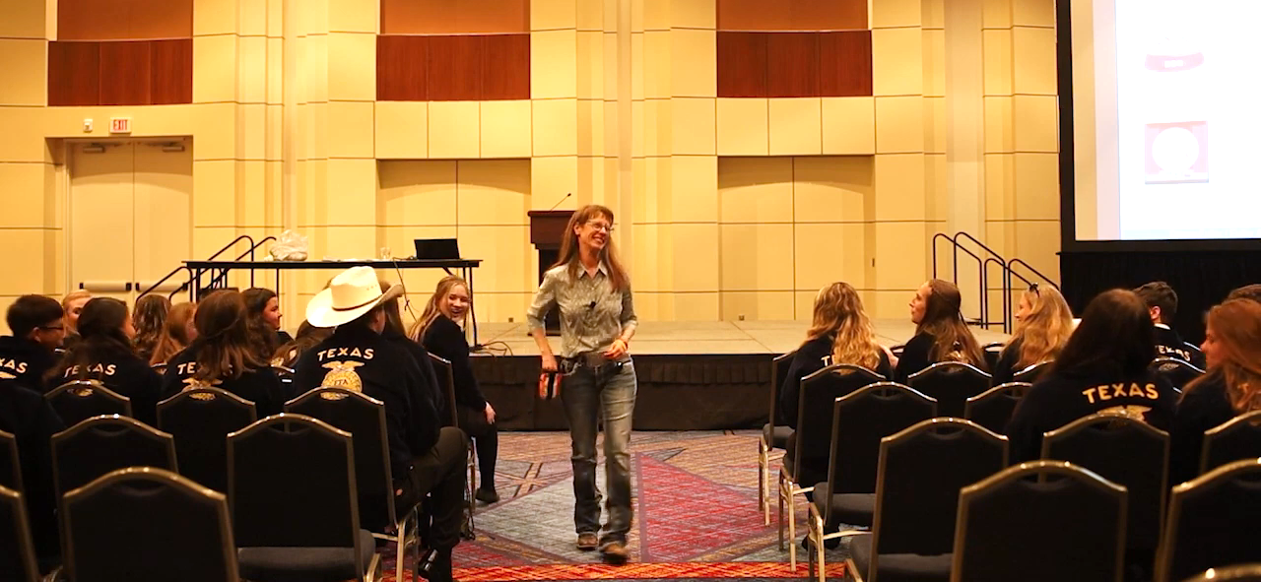
Where does
Donna live?
In a barndominium
In a condominium
In a constant state of delirium
In an institution
In a barndominium
c. Goat
What kind of farmer is Donna?
Dandelion
Dirt
Goat
Lousy
b. Shoveling manure
Which of these is NOT considered a superpower?
Strengths
Shoveling manure
Skills
Passions
d. Student success cultivator
What is Donna’s job?
Rodeo princess
Techy nerd
Sewage pumper-outer
Student success cultivator
c. Don’t Farm Naked
Which of these true book titles is the name of Donna’s book?
How to Teach Quantum Physics to Your Dog
The Joy of Boiling Water
Don’t Farm Naked
How to Train Your Goldfish
b. Helping AG people harvest successful lives
What is Donna super passionate about?
Liver
Helping AG people harvest successful lives
Cleaning her house
Math and Science

